Slide 1
BANL – 6900 - 02
BUSINESS ANALYTICS CAPSTONE
Project Topic- Los Angeles Crime Data Analysis
May 04, 2024
Submitted by:
Antara Moundekar
Shravanthi Logishetty
Pavani Badam

Slide 2






CONTENTS
ABSTRACT INTRODUCTION
BUSINESS PROFILE IDENTIFICATION
METHODOLOGY
VISUAL INSIGHTS
CONCLUSION

Slide 3


ABSTRACT
This research examines Los Angeles crime data from 2020 to March 1, 2024. It identifies trends and hotspots using sophisticated analytics to aid communities, lawmakers, and law enforcement in their efforts to avoid crime.

Slide 4

INTRODUCTION
In today's world, data helps us understand crime better. This study looks at crime in Los Angeles from 2020 onwards. We use special tools like R and Power BI to see where and when crimes happen. By doing this, we can help insurance companies make better plans to protect people and fight fraud. This research is all about making insurance safer and helping communities in Los Angeles stay protected.

Slide 5
BUSINESS PROBLEM IDENTIFICATION
Enable businesses to make informed decisions in choosing safe neighborhoods in Los Angeles through data analytics.
Empower real estate, security services, and insurance companies to leverage crime data analytics.
Optimize property investments, resource placement, and insurance premiums based on location-specific risks.
Enhance neighborhood safety and efficacy in resource deployment.
Foster economic growth and maintain public safety through data-driven decision-making.

Slide 6
METHODOLOGY
Data Collection
DATA COLLECTION
The LAPD crime dataset which covers the Los Angeles crime data from January 2020 to March 1st, 2024.
The dataset contains information on the date, time, types of crimes, locations of incidents, and victim demographics.
DATA CLEANING
Apply careful data cleaning processes to address missing values, inconsistencies, and anomalies.
Methods include managing null values, standardizing data formats, and ensuring uniformity across records.
Data Cleaning & Preparation
Exploratory Data Analysis
Descriptive Analytics (Cluster Analysis)

Slide 7
METHODOLOGY
EXPLORATORY DATA ANALYSIS
Utilize statistical tools in R for exploratory data examination, distribution, and variance analysis across neighborhoods and crime types.
Visualizations such as histograms, barplots, and temporal plots in Power BI reveal spatial and temporal crime patterns.
DESCRIPTIVE ANALYTICS
Analyze past crime data to identify general trends, patterns, and variances in crime rates over time and across different Los Angeles neighborhoods using cluster analysis.
Examine aggregate statistics to understand crime frequency, crime areas, and distribution across gender.

Slide 8
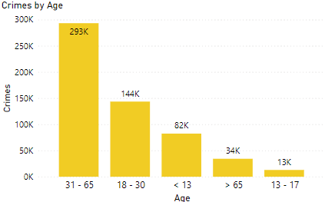
VISUAL INSIGHTS – UNCOVERING CRIME PATTERNS
Age Group Analysis: The chart illustrates crime counts across different age groups. Notably, the age group 31-65 exhibits the highest count at 293K, followed by 18-30 at 144K. Conversely, the age group 13-17 shows the lowest count at 13K.Graduates are 11 participants, constituting 41% of total respondents. 82% are international students, with 18% being domestic.

Slide 9
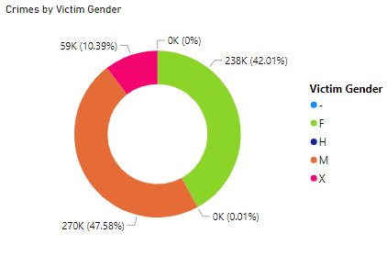
VISUAL INSIGHTS – UNCOVERING CRIME PATTERNS
Gender Analysis: The pie chart displays the distribution of crime based on gender. Females account for 238K incidents, constituting 42.01% of the total. Males represent the majority with 270K cases, accounting for 47.58%. The category 'X' or unknown gender comprises 59K incidents, making up 10.39% of the total."

Slide 10
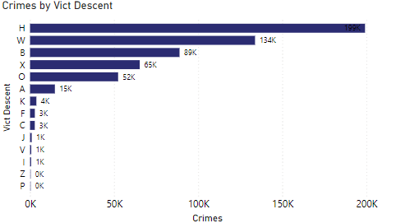
VISUAL INSIGHTS – UNCOVERING CRIME PATTERNS
The clustered bar chart depicts crime counts across different ethnicities. Hispanic/Latin/Mexican individuals have the highest count at 199K incidents, while Pacific Islanders (S) and Asian Indians show no recorded incidents. White individuals account for 134K incidents.
Vict Descent - Descent Code: A - Other Asian B - Black C - Chinese D - Cambodian F - Filipino G - Guamanian H - Hispanic/Latin/Mexican I - American Indian/Alaskan Native J - Japanese K - Korean L - Laotian O - Other P - Pacific Islander S - Samoan U - Hawaiian V - Vietnamese W - White X - Unknown Z - Asian Indian

Slide 11
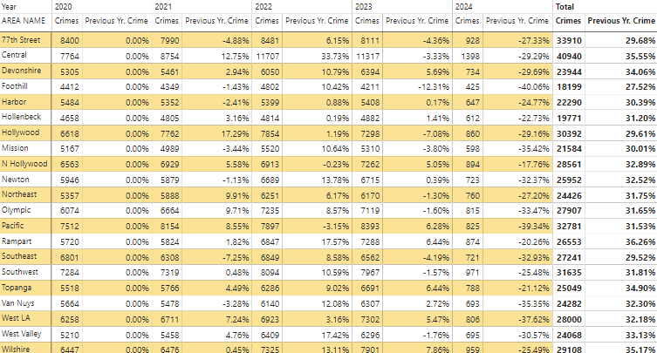
VISUAL INSIGHTS – UNCOVERING CRIME PATTERNS
This data, coupled with the percentage change in crime count from the previous year, offers valuable insights into the fluctuating crime trends across these regions. The table reveals crime statistics across various areas from 2020 to May 2024. Notably, the Central and Wilshire areas consistently exhibit the highest crime rates, around 35% in total. Conversely, most areas maintain crime rates around 31-32%.

Slide 12
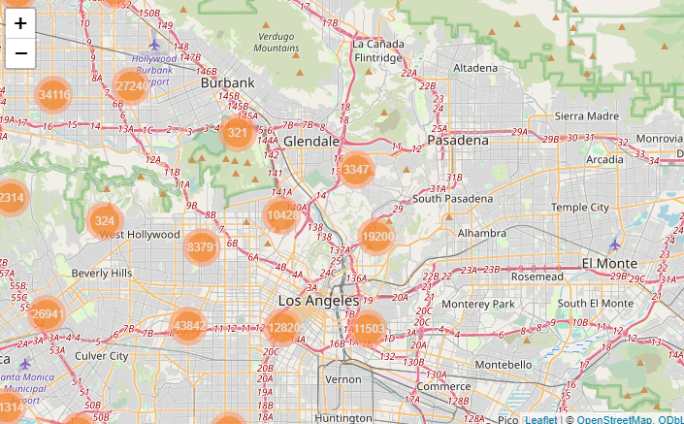
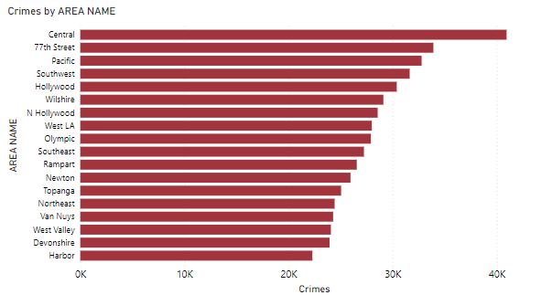
VISUAL INSIGHTS – UNCOVERING CRIME PATTERNS
The heat map visually highlights major crime hotspots across the city, providing a spatial representation of crime intensity.
The bar chart displays crime counts categorized by area name, offering a comparative analysis of crime distribution across different regions.

Slide 13
CONCLUSION
The Los Angeles crime map analysis shows that East Los Angeles, Pasadena, and Glendale are particularly safe communities with low crime rates.
Insights gathered from crime analysis across age groups, genders, and races facilitate informed decision-making.
Businesses in Los Angeles may maximize investments, improve safety, and promote economic growth by utilizing crime data analytics.
Also, Individuals and companies looking for safer areas in the Los Angeles region to live, invest in, or conduct other operations can use this information to help them make decisions.

Slide 14
Thank You

